Slide 1
Angular 8 - Day 4
Services and More Routing

Slide 2
Vignesh Murali Natarajan (119780), Edited by Jason Monroe (688776)
Veteran Trainer, Project Manager and Solution Architect with 14 years of technical training experience and 12 technical certifications on Java, Mobile, Web, Architecture, Design and Development
2.0, May 2019

Slide 3

Objectives
In this session we would be covering the following topics:
Services in Angular 8
Injectable Decorator
Dependency Injection
Route Parameters
Creating in app-routing.module.ts
Linking
Retrieving parameters in component class
Child Routes

Slide 4
Shared Data Across Components
What do we do when data is needed across several components?
Scenario: We want the bio page in our HelloAngular app to just display the names of the Developers. We want the user to have the ability to click on a Developer and it will take us to a details page.
This can be accomplished with Services and Route Parameters

Slide 5
Services

Slide 6
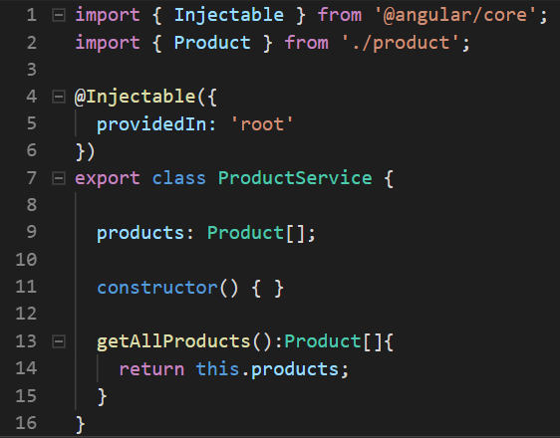
Services
Create a Service using the command:
Services expose methods (supposedly business logic) as API along with optional public properties.
Services are dependencies injected by Angular, which maintains each service as a singleton.
The @Injectable decorator is used to mark a Typescript class as a Service.
providedIn: Determines which injectors will provide the injectable, by either associating it with an @NgModule or other InjectorType, or by specifying that this injectable should be provided in the 'root' injector, which will be the application-level injector in most apps.
ng g service <<ServiceName>>

Slide 7
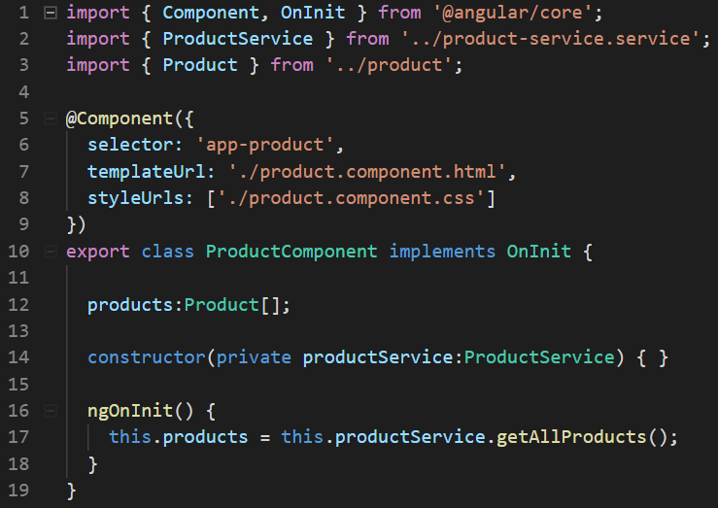
Dependency Injection (Contd.)
Injecting a service is as simple as importing the service class and then defining it within the constructor parameters of the consumer.
They must have the ‘private’ access modifier
.

Slide 8

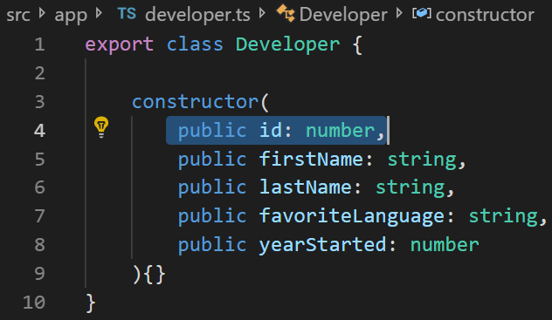
HelloAngular – Add Developer Service
Generate Developer Service(ng g service developer)
Migrate dev info from bio.component.ts to developer
Update developer.ts class with an id field
Give each developer an id in the new Service
Create a method called getAllDevelopers and return the internal array.
Inject Developer Service into bio.component.ts
Dependency injection in constructor
Assign to class member/property
Notes:
Instructions to Trainer:
Instructions to Facilitator:

Slide 9
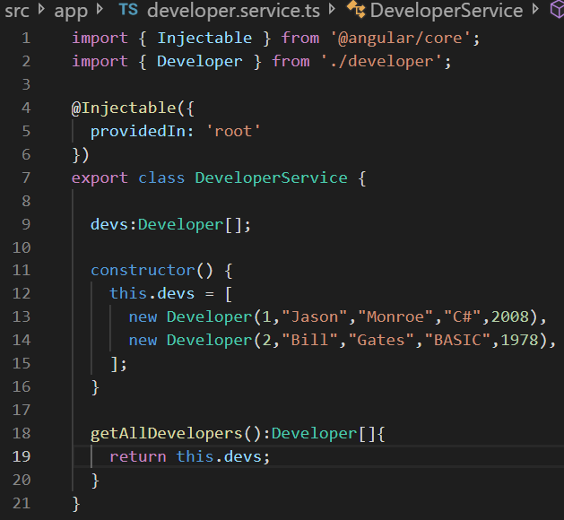
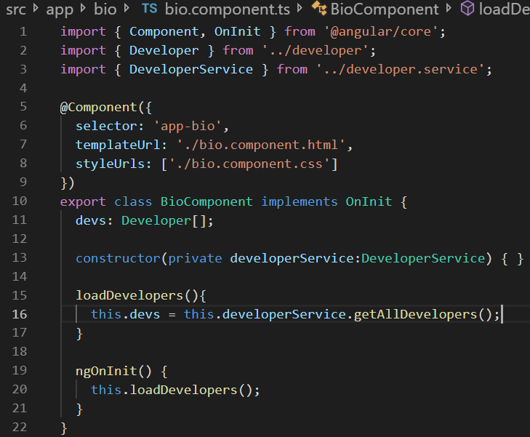
HelloAngular Developer Service
Service
Service injected into bio.component.ts

Slide 10
More Routing

Slide 11
Sending Route Parameters
Parameters are sent using :paramName embedded on to the router paths, as shown below:
export const routes: Routes = [
{ path: '', redirectTo: 'product-list', pathMatch: 'full' },
{ path: 'product-details/:id', component: ProductDetails }
];
The parameter can then be sent using routerLink and interpolation:
<a routerLink=“product-details/{{product.id}}”
OR the routerLink directive may be used and supplied with parameters to be automatically sent, while invoking a router link.
<a *ngFor="let product of products"
[routerLink]="['/product-details', product.id]">
{{ product.name }}
</a>

Slide 12
Routing Parameters
Reading Route Parameters:
Angular provides the ActivatedRoute service, which in turn supplies a paramMap property which contains the parameters.
export class TestComponent implements OnInit {
constructor(private route: ActivatedRoute) {}
ngOnInit() {
this.sub = this.route.snapshot.paramMap.get('id');
});
}

Slide 13
Routing Parameters
Navigating to parameterized routes internally:
Create a Router object and use the navigate method.
Pass an array containing the main route and the parameter (just like routerLink directive on previous page)
Constructor(private router:Router){}//import Router from ‘@angular/router’
goToProductDetails(id) {
this.router.navigate(['/product-details', id]);
}

Slide 14
HelloAngular – Add Route Parameters
Generate a new component called BioDetails (ng g component BioDetails)
Add a parameterized route to app-routing.module.ts
Import BioDetailsComponent
Create route with :id parameter that directs to BioDetails Component
Change bio.component.html
Only Display Developer’s name
Surround with routerLink pointing to bio/:id
Add method to DeveloperService to retrieve a Developer by Id
Call method getDeveloperById
Use .find() method and arrow syntax on devs array
Return developer object
Finish BioDetails
Inject an ActivatedRoute and DeveloperService Object
Use route snapshot to get params[‘id’]
Use getDeveloperById method to store the developer in member / property
Display in bio-details.component.html
Notes:
Instructions to Trainer:
Instructions to Facilitator:

Slide 15
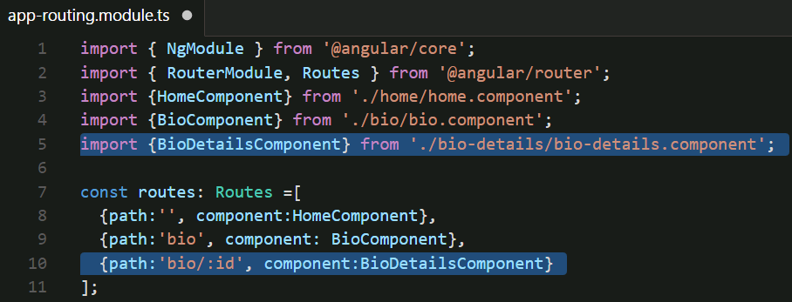
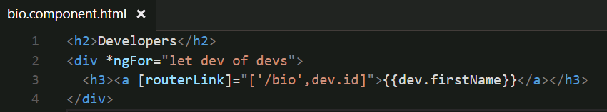
HelloAngular – Using Route Parameters
#2 ->
#3 ->

Slide 16
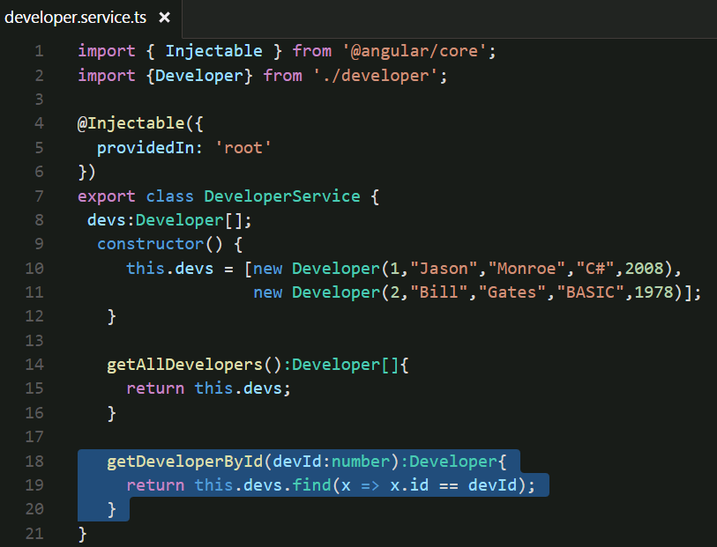
HelloAngular – Using Route Parameters
#4 ->

Slide 17
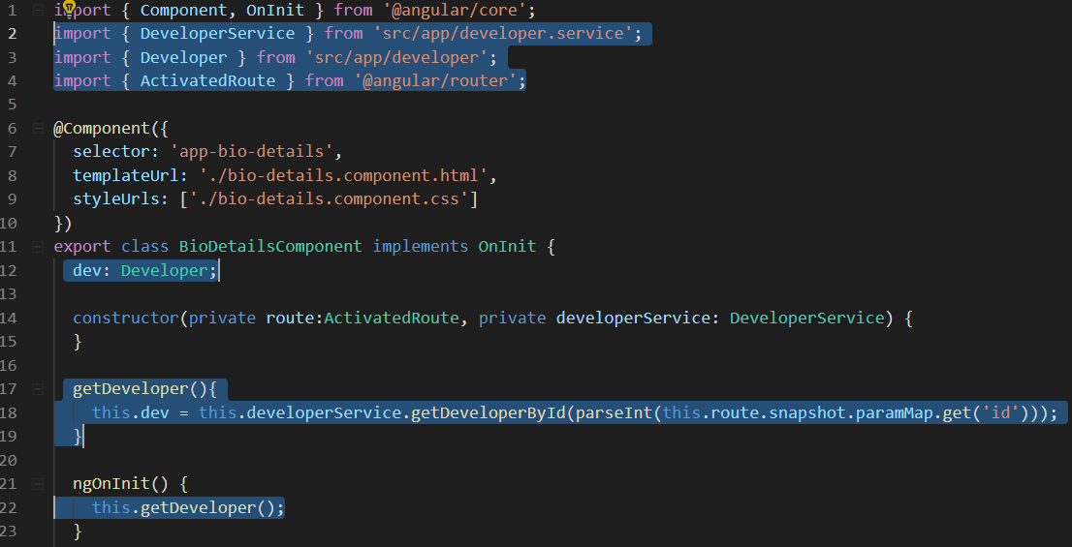
HelloAngular – Using Route Parameters
#5 ->

Slide 18
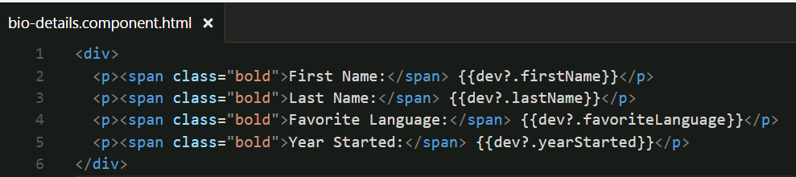
HelloAngular – Using Route Parameters
#6

Slide 19
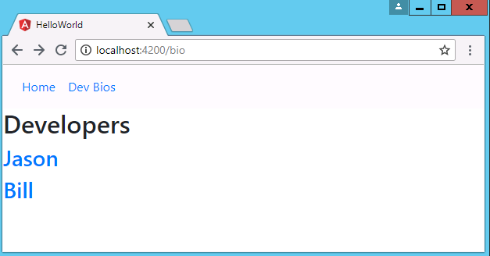
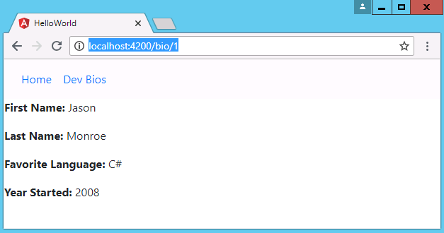
HelloAngular – Using Route Parameters

Slide 20
Route Children
When some routes may only be accessible and viewed within other routes, it may be appropriate to create them as child routes. See the following instance.
export const routes: Routes = [
{ path: '', redirectTo: 'product-list', pathMatch: 'full' },
{ path: 'product-details/:id', component: ProductDetails,
children: [
{ path: '', redirectTo: 'overview', pathMatch: 'full' },
{ path: 'overview', component: Overview },
{ path: 'specs', component: Specs }
]
}
];
The component with the children routes must have a router-outlet to hold the output of the children.
@Component({
selector: 'product-details',
template: `
<p>Product Details: {{id}}</p>
<nav>
<a [routerLink]="['overview']">Overview</a>
<a [routerLink]="['specs']">Technical Specs</a>
</nav>
<router-outlet></router-outlet>
`
})

Slide 21

Learn How - Demonstration
Demo: Router Children
https://github.com/CognizantFSE/Angular-Child-Routes
Notes:
Instructions to Trainer:
Instructions to Facilitator:

Slide 22


Questions

Slide 23
Test Your Understanding
What is a Service?
How do you create a Service?
What is Dependency Injection?
What is Routing?
How to pass parameters to a route?
How do you create Child Routes?
Notes:
Instructions to Trainer:
Instructions to Facilitator:

Slide 24
You have successfully completed
Angular 8 - Day 5
Services and More Routing

